Slide 1
Table of Contents
This slide deck consists of slides used in 3 lecture videos in Week 5. Below is a list of shortcut hyperlinks for you to jump into specific sections.
(page 2) Week 5: Owned Rows in Django - Overview
(page 9) Week 5: Owned Rows in Django - Generic Views Review
(page 14) Week 5: Owned Rows in Django - owner.py
Notes:
Note from Chuck. If you are using these materials, you can remove my name and URL from this replace it with your own, but please retain the CC-BY logo on the first page as well as retain the entire last page when you remix and republish these slides.
TO Highlight – go to https://tohtml.com/html/ - paste and then do a "Paste RTF"

Slide 2

Django Owned Rows
Charles Severance
www.dj4e.com
https://samples.dj4e.com/myarts/
https://github.com/csev/dj4e-samples/

Slide 3
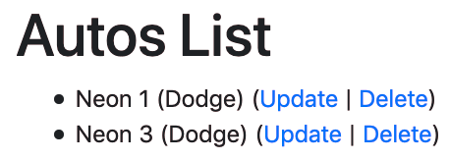
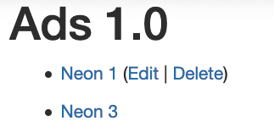
Who Can Edit Which Row?
In our Autos CRUD assignment, any user could edit any row. But in real systems, different users own each row in a data model and we only allow a user to edit /modify the row(s) that "belong to them".

Slide 4
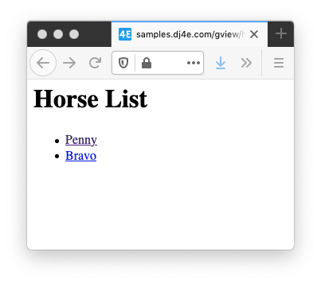
Rows
dj4e-samples/gview/views.py
from django.views import generic
from gview.models import Horse
class HorseListView(generic.ListView):
model = Horse
https://samples.dj4e.com/gview/horses
dj4e-samples/gview/templates/gview/horse_list.html
<h1>Horse List</h1>
<p>
{% if horse_list %}
<ul>
{% for horse in horse_list %}
<li>
<a href="{% url 'gview:horse' horse.id %}">
{{ horse.name }}</a>
</li>
{% endfor %}
</ul>
{% else %}
<p>There are no horses in the database.</p>
{% endif %}
</p>

Slide 5
Rows
dj4e-samples/gview/views.py
from django.views import generic
from gview.models import Horse
class HorseListView(generic.ListView):
model = Horse
gview.views.HorseListView
model = gviews.models.Horse
dj4e-samples/gview/templates/gview/horse_list.html
django.views.generic.ListView
<h1>Horse List</h1>
<p>
{% if horse_list %}
<ul>
{% for horse in horse_list %}
<li>
<a href="{% url 'gview:horse' horse.id %}">
{{ horse.name }}</a>
</li>
{% endfor %}
</ul>
{% else %}
<p>There are no horses in the database.</p>
{% endif %}
</p>

Slide 6
Rows
dj4e-samples/myarts/views.py
from myarts.models import Article
from myarts.owner import OwnerListView
class ArticleListView(OwnerListView):
model = Article
myarts.views.ArticleListView
model = myarts.models.Article
dj4e-samples/myarts/templates/myarts/article_list.html
myarts.owner.OwnerListView
<ul>
{% for article in article_list %}
<li>
<a href="{% url 'myarts:article_detail' article.id %}">
{{ article.title }}</a>
{% if article.owner == user %}
(<a href="{% url 'myarts:article_update' article.id %}">
Edit</a> |
<a href="{% url 'myarts:article_delete' article.id %}">
Delete</a>)
{% endif %}
</li>
{% endfor %}
</ul>
django.views.generic.ListView

Slide 7
Inheritance (Review)
When we make a new class - we can reuse an existing class and inherit all the capabilities of an existing class and then add our own little bit to make our new class
Another form of store and reuse
Write once - reuse many times
The new class (child) has all the capabilities of the old class (parent) - and then some more

Slide 8

Terminology: Inheritance
‘Subclasses’ are more specialized versions of a class, which inherit attributes and behaviors from their parent classes, and can introduce their own.
http://en.wikipedia.org/wiki/Object-oriented_programming

Slide 9
Inside a Generic Edit View
(review)

Slide 10
Edit Form Flow
GET Request
Load Data
Cancel
Error 404 Page
Error?
Form with old data
Edit Data
model
POST with data
Fix Data
Validate Data
Form with old data
Error?
Cancel
Load Data
Error 404 Page
Error?
Store Data
Redirect to success URL
Message
GET success URL
Make Page
Success page Yay!

Slide 11
Edit Form Flow
class django.views.generic.list.ListView
A page representing a list of objects. While this view is executing, self.object_list will contain the list of objects (usually, but not necessarily a queryset) that the view is operating upon.
Method Flowchart
setup()
dispatch()
http_method_not_allowed()
get_template_names()
get_queryset()
get_context_object_name()
get_context_data()
get()
render_to_response()
https://docs.djangoproject.com/en/3.0/ref/class-based-views/generic-display/#django.views.generic.list.ListView

Slide 12
Edit Form Flow
GET Request
get_query_set()
Cancel
Error 404 Page
Error?
get_context_data()
Form with old data
Edit Data
model
POST with data
Fix Data
Validate Data
get_context_data()
Form with old data
Error?
get_query_set()
Cancel
Error 404 Page
Error?
Store Data
Redirect to success URL
Message
GET success URL
Make Page
Success page Yay!

Slide 13
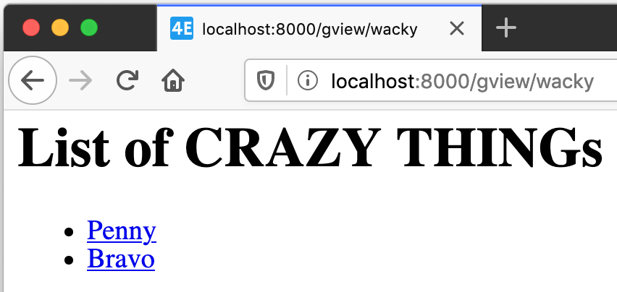
Edit Form Flow
dj4e-samples/gview/views.py
https://samples.dj4e.com/gview/wacky
# Lets explore how (badly) we can override things...
class WackyEquinesView(generic.ListView):
model = Car
template_name = 'gview/wacky.html'
def get_queryset(self, **kwargs):
crazy = Horse.objects.all() # Convention: Car
return crazy
def get_context_data(self, **kwargs):
context = super().get_context_data(**kwargs)
context['crazy_thing'] = 'CRAZY THING'
return context
dj4e-samples/gview/templates/gview/wacky.html
<h1>List of {{ crazy_thing }}s</h1>
<p>
{% if horse_list %}
<ul>
{% for xyz in horse_list %}
<li>
<a href="{% url 'gview:horse' xyz.id %}">{{ xyz.name }}</a>
</li>
{% endfor %}
...

Slide 14
Owner List View
https://samples.dj4e.com/myarts/
https://github.com/csev/dj4e-samples/

Slide 15
Owner List View
dj4e-samples/myarts/views.py
from myarts.models import Article
from myarts.owner import OwnerListView
class ArticleListView(OwnerListView):
model = Article
myarts.views.ArticleListView
model = myarts.models.Article
dj4e-samples/myarts/templates/myarts/article_list.html
myarts.owner.OwnerListView
<ul>
{% for article in article_list %}
<li>
<a href="{% url 'myarts:article_detail' article.id %}">
{{ article.title }}</a>
{% if article.owner == user %}
(<a href="{% url 'myarts:article_update' article.id %}">
Edit</a> |
<a href="{% url 'myarts:article_delete' article.id %}">
Delete</a>)
{% endif %}
</li>
{% endfor %}
</ul>
django.views.generic.ListView

Slide 16
Owner List View
dj4e-samples/myarts/models.py
from django.db import models
from django.core.validators import MinLengthValidator
from django.contrib.auth.models import User
from django.conf import settings
class Article(models.Model) :
title = models.CharField(
max_length=200,
validators=[MinLengthValidator(2, "Title must be greater than 2 characters")]
)
text = models.TextField()
owner = models.ForeignKey(settings.AUTH_USER_MODEL, on_delete=models.CASCADE)
created_at = models.DateTimeField(auto_now_add=True)
updated_at = models.DateTimeField(auto_now=True)
# Shows up in the admin list
def __str__(self):
return self.title
A foreign key to a table that belongs to Django

Slide 17
Owner List View
dj4e-samples/myarts/views.py
from myarts.models import Article
from myarts.owner import OwnerListView,OwnerDetailView,OwnerCreateView,OwnerUpdateView,OwnerDeleteView
class ArticleListView(OwnerListView):
model = Article
# By convention:
# template_name = "myarts/article_list.html"
class ArticleDetailView(OwnerDetailView):
model = Article
class ArticleCreateView(OwnerCreateView):
model = Article
fields = ['title', 'text']
class ArticleUpdateView(OwnerUpdateView):
model = Article
fields = ['title', 'text']
class ArticleDeleteView(OwnerDeleteView):
model = Article

Slide 18
Create Form Flow
GET Request
Cancel
Empty Form
Enter Data
model
POST with data
Fix Data
Validate Data
Form with old data
Error?
Cancel
Store Data
Redirect to success URL
Message
GET success URL
Make Page
Success page Yay!

Slide 19
Create Form Flow
class django.views.generic.edit.ModelFormMixin
A form mixin that works on ModelForms, rather than a standalone form
get_success_url()
Determine the URL to redirect to when the form is successfully validated. Returns success_url if it is provided; otherwise, attempts to use the get_absolute_url() method of the object.
form_valid(form)
Saves the form instance, sets the current object for the view, and redirects to get_success_url().
form_invalid(form)
Renders a response, providing the invalid form as context.
https://docs.djangoproject.com/en/3.0/ref/class-based-views/mixins-editing/#modelformmixin

Slide 20
Create Form Flow
GET Request
Cancel
Empty Form
Enter Data
model
POST with data
Fix Data
Validate Data
Form with old data
Error?
Cancel
form_valid()
Redirect to success URL
Message
GET success URL
Make Page
Success page Yay!

Slide 21
Create Form Flow
dj4e-samples/myarts/owner.py
from django.views.generic import CreateView, UpdateView, DeleteView, ListView, DetailView
from django.contrib.auth.mixins import LoginRequiredMixin
class OwnerCreateView(LoginRequiredMixin, CreateView):
"""
Sub-class of the CreateView to automatically pass the Request to the Form
and add the owner to the saved object.
"""
# Saves the form instance, sets the current object for the
# view, and redirects to get_success_url().
def form_valid(self, form):
print('form_valid called')
object = form.save(commit=False)
object.owner = self.request.user
object.save()
return super(OwnerCreateView, self).form_valid(form)

Slide 22
Create Form Flow
dj4e-samples/myarts/owner.py
from django.views.generic import CreateView, UpdateView, DeleteView, ListView, DetailView
from django.contrib.auth.mixins import LoginRequiredMixin
class OwnerUpdateView(LoginRequiredMixin, UpdateView):
"""
Sub-class the UpdateView to pass the request to the form and limit the
queryset to the requesting user.
"""
def get_queryset(self):
print('update get_queryset called')
""" Limit a User to only modifying their own data. """
qs = super(OwnerUpdateView, self).get_queryset()
return qs.filter(owner=self.request.user)

Slide 23
Edit Form Flow
GET Request
get_query_set()
Cancel
Error 404 Page
Error?
get_context_data()
Form with old data
Edit Data
model
POST with data
Fix Data
clean()
get_context_data()
Form with old data
Error?
get_query_set()
Cancel
Error 404 Page
Error?
form_valid()
Redirect to success URL
Message
GET success URL
Make Page
Success page Yay!

Slide 24
Edit Form Flow
dj4e-samples/myarts/models.py
from django.db import models
from django.core.validators import MinLengthValidator
from django.contrib.auth.models import User
from django.conf import settings
class Article(models.Model) :
title = ...
text = models.TextField()
owner = models.ForeignKey(settings.AUTH_USER_MODEL, on_delete=models.CASCADE)
created_at = models.DateTimeField(auto_now_add=True)
updated_at = models.DateTimeField(auto_now=True)
dj4e-samples/myarts/views.py
from myarts.models import Article
from myarts.owner import OwnerDeleteView
class ArticleDeleteView(OwnerDeleteView):
# By convention, template='myarts/article_confirm_delete.html'
model = Article

Slide 25
Summary
We can extend the generic edit views to support an owner field in our model that is automatically populated
By understanding and using Django in a a proper object oriented manner our code can be very simple and minimize repetition for common features
Avoids filling views with boilerplate as the views get more complex

Slide 26
Acknowledgements / Contributions
These slides are Copyright 2020- Charles R. Severance (www.dr-chuck.com) as part of www.dj4e.com and made available under a Creative Commons Attribution 4.0 License. Please maintain this last slide in all copies of the document to comply with the attribution requirements of the license. If you make a change, feel free to add your name and organization to the list of contributors on this page as you republish the materials.
Initial Development: Dr. Charles R. Severance, University of Michigan School of Information
Insert new Contributors and Translators here including names and dates
Continue new Contributors and Translators here

Slide 27
Additional Source Information
Snowman Cookie Cutter" by Didriks is licensed under CC BY https://www.flickr.com/photos/dinnerseries/23570475099

